Slide 1
Sales Superstore
File created on: 6/22/2021 3:56:12 PM

Slide 2
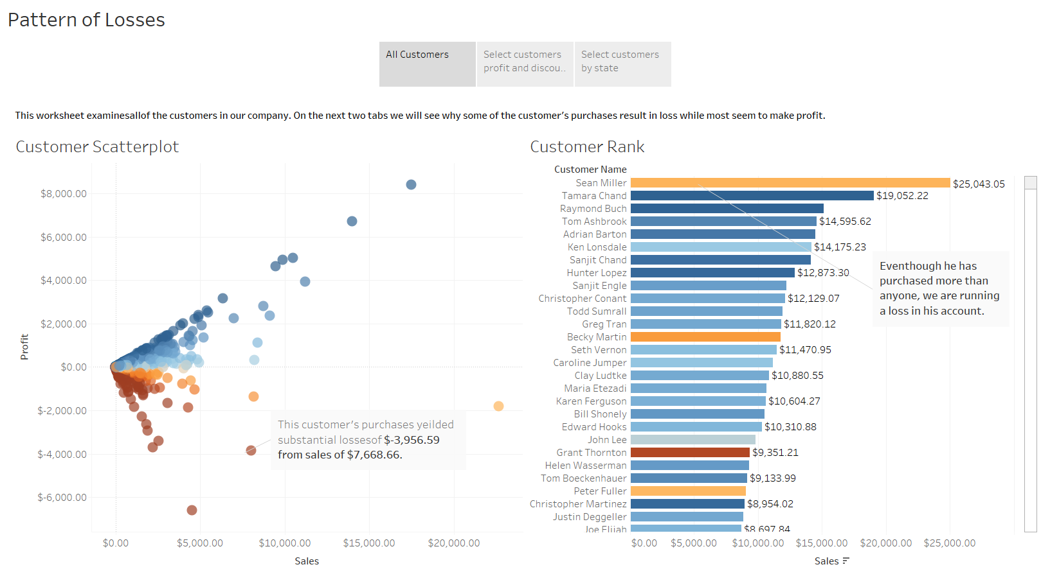

Slide 3
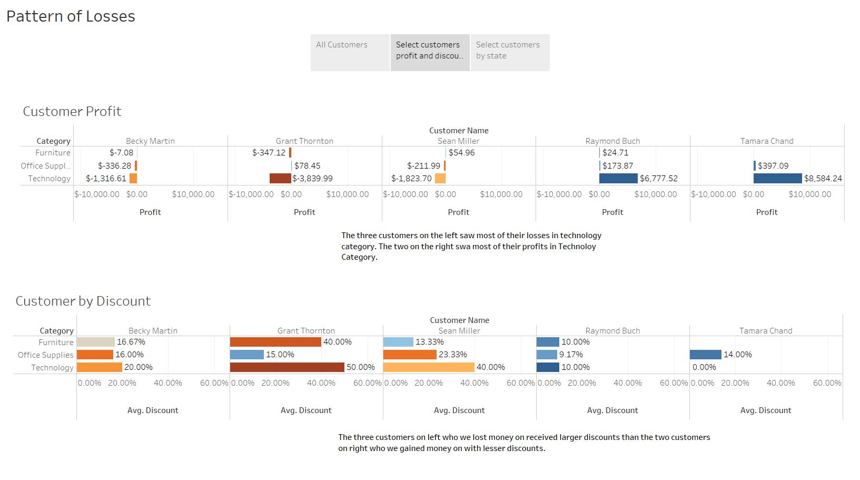

Slide 4
